Slide 1
Subject Name : DATABASE MANAGEMENT SYSTEM Presentation Title: MONGO DB
JEPPIAAR INSTITUTE OF TECHNOLOGY
“Self-Belief | Self Discipline | Self Respect”
Department of Computer Science and Engineering
Team Members:
Students Name Reg.No:
1.Haarish Kannan 210618104017
2.Joan Prince 210618104020
3.Keshav 210618104026
4.Lakshman Prasath 210618104027
5.Sivanesh 210618104048
6.Sri Hari 210618104049

Slide 2
Objective
To Design/ Analyze/ Evaluate
MongoDB is a document-oriented NoSQL database used for high volume data storage. MongoDB is a database which came into light around the mid-2000s. It falls under the category of a NoSQL database. Classified as a NoSQL database program, MongoDB uses JSON-like documents with schema. MongoDB is developed by MongoDB Inc. and licensed under the Server Side Public License (SSPL).

Slide 3
What is a NoSQL DB ?
NoSQL stands for not only SQL it provides a way to store and retrieve the data that is stored in tabular format as in relational databases. It is a complementary addition to SQL and Relational databases. These are flexible database management systems that provide the way to store and process both structured and semi-structured data which RDBMS tools cannot process.

Slide 4
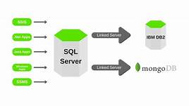
Block Diagram/ Work Flow/ Flow Chart

Slide 5
Advantages of NoSQL over SQL
NoSQL databases can process unstructured data sets as well as semi - structured data sets
NoSQL DBs are made for complex analytical tasks. The typical querying language can be used to do atomic querying
NoSQL DBs are designed to scale out as time progresses, means they make a huge difference in the Big-O’s of the analytical methods when compared to the traditional RDBMS
NoSQL DBs offer huge flexibility when it comes to data storage as you typically won’t be using any of your old-school stuff such as tables and rows for data storage

Slide 6
Key components in MongoDB
_id : The _id field is the equivalent of primary key in RDBMS. The _id field is absolutely unique across the DB, and if the user doesn’t provide one MongoDB will automatically generate a 24 digit code and assign to it
Collection : Collection is a group of MongoDB documents. This is similar to the tables in RDBMS. Though these collections doesn’t enforce any sort of order or structure
Cursor : Cursor is a pointer to the result set of a query. The users can iterate through a cursor to perform various operations
Database : Database is a group of Collections. Databases are implemented through the file management system. A MongoDB server can have multiple Databases.

Slide 7
Advantages of MongoDB
Schema - Less : MongoDB doesn’t have a database schema. It simply stores the data as name - value pairs in it’s document. This leads to easy development and maintenance of the database
Sharding : Large amounts of data can be easily stored in MongoDB by distributing the data among the servers. The biggest advantage of sharding is that it is completely fail proof
High - Speed : As a result of storing documents in a JSON like format, it becomes possible for the user to index the records thus providing faster query times. MongoDB is a 100 times faster than the traditional RDBMs
Technical support : MongoDB provides technical support round the clock and all these techies actually work at MongoDB rather than being outsourced

Slide 8
Disadvantages of MongoDB
High - memory : As MongoDB stores the data is key - value pairs, it allocates storage for every key made, this leads to redundancy thus dramatically using large amounts of data
Joints Unsupported : You cannot make joints between two documents in MongoDB. Creation of joints in RDBMS between tables is very common
Limited Document Size : A document cannot be more than a size of 16 MB
Limited Nesting : You cannot nest documents within documents on more than a 100 levels

Slide 9
Companies that uses MongoDB
Coinbase
SEGA HARDlight
City Government of Chicago
Nokia
Adobe
Electronic Sports
eBay

Slide 10
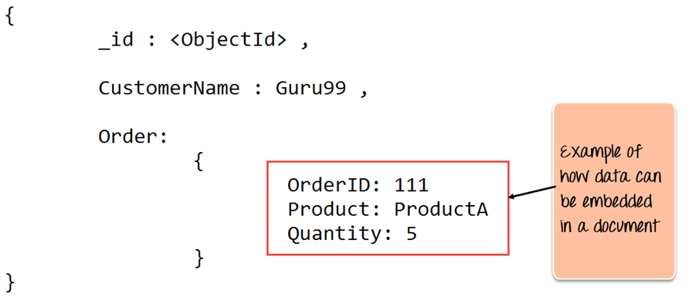
Result & Discussion

Slide 11
Future Scope
As MongoDB is a non - relational database, the short answer is that it is going nowhere for at least the next decade as most companies are transitioning towards the NoSQL trend. As storage isn’t a problem these days companies are more oriented towards faster analysis of data rather than conserving the storage aspect of databases
Even though developing models to extract information from Non - relational databases can be a real pain but the scalability of the model and the data sets is really worth that few extra hours of development
Even though NoSQL’s in general showcase a lot of advantages, storage and operating structured data on these is really a joke, as one could achieve the same task through a RDBMS by not only a faster rate but also with minimum margin of error. So, still when it comes to structured data sets RDBMS is the king.

Slide 12
Reference
Linkedin website
Wikipedia
MONGO DB World (Youtube channel).
Tutorials Point (Youtube channel).

